Slide 1
MyomiR-OsteomiR Crosstalk Induced by Different Modes and Intensities of Exercise Training and its Role in Controlling Osteogenic Differentiation in Old Male Wistar Rats Zohreh Shanazari¹, Zahra Hemati Farsani², Mohammad Faramarzi³, Ebrahim Banitalebi1
¹Department of Sport Sciences, Shahrekord University, Shahrekord, Iran
2Department of Sport Sciences, Ardakan University, Ardakan, Iran
³Department of Exercise Physiology, University of Isfahan, Isfahan, Iran

Slide 2
Introduction
Osteoporosis and sarcopenia are known as geriatric syndromes, age-related musculoskeletal diseases, as well as major public health problems in the elderly population
Skeletal muscle contraction can thus lead to a major challenge to the whole-body homeostasis. Inter-organ communication network during ET between several different tissues can be further mediated by some ET-induced myokines. It has been correspondingly well established that myokines directly and simultaneously affect muscle-bone metabolism. On the other hand, bone-derived hormones, i.e., osteokines, are important regulators of muscle metabolism and adaptation to, so that osteokines can modulate myogenesis

Slide 3
the present study aimed to determine the relationship between the changes in myomiRs (namely, miR-1, miR-206, miR-133), osteomiRs (viz. miR-204, miR-103a, and miR-133a), and myostatin and osteoblast differentiation markers (i.e., runt-related transcription factor 2 [RUNX2] and peroxisome proliferator-activated receptor gamma [PPARγ]) induced by different ET modes and intensities in old male Wistar rats.

Slide 4
Methodology
A total number of 50 old male Wistar rats (23 months of age), the rats were then randomly assigned to four experimental groups, including moderate-intensity endurance training (MIET), high-intensity endurance training (HIET), moderate-intensity resistance training (MIRT), high-intensity resistance training (HIRT), and control (CON).
Notes:
(Research Method, Population and Sample, Sampling methods, tools, data analysis methods)

Slide 5
Results

Slide 6
Results

Slide 7
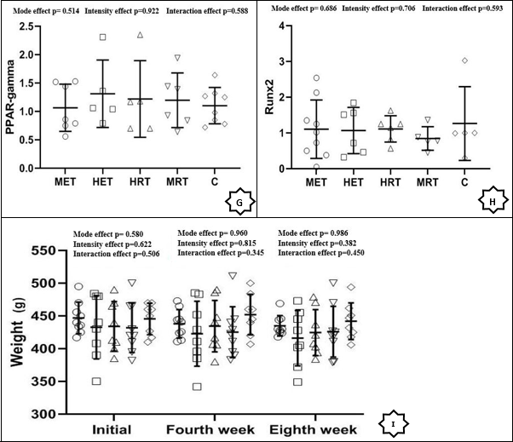
Results

Slide 8
Results

Slide 9
Discussion and Conclusion
The study findings hint at the possible contribution of some osteoblast differentiation markers in attenuating bone dysfunction during different exercise training modes and intensities, which possibly happens through some myomiRs regulating gene networks engaged in transdifferentiation of adipocytes to osteoblasts.
- It was concluded that individual myomiRs involved in myoblast and osteoblast differentiation might not be responsible for the response of myogenic and osteogenic targets to physical activity and exercise training

Slide 10
Applications and Executive Suggestions
It is recommended to increase the duration of training in the elderly and MicrRNAs involved in hypertrophy and osteogenesis in muscle and bone tissue are measured during the intervention period

