Slide 1
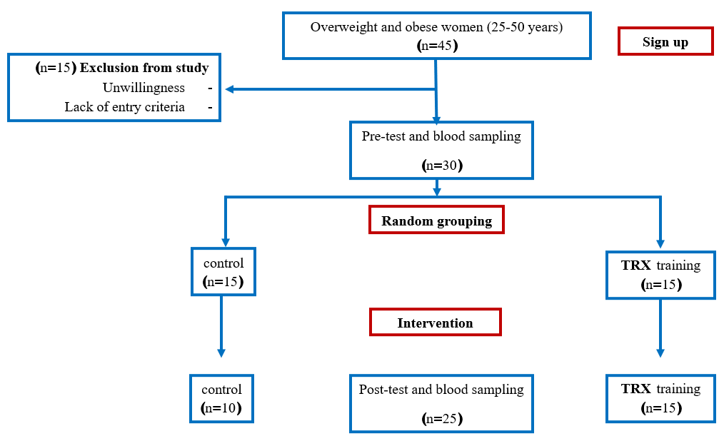
The effect of TRX suspended resistance training on liver enzymes in obese women
Hasti Sherizadeh, Mostafa Rahimi, Ebrahim Banitalebi
Code: 1311-SSRC-13TH
Introduction:
Fatty liver disease is defined as a disease of the liver cells that has recently increased due to the increase in obesity in our society. The obesity epidemic is closely related to the increasing prevalence of non-alcoholic fatty liver disease. Due to the high prevalence of obesity and fatty liver disease caused by obesity, finding an effective and useful solution seems crucial. Cross-sectional studies confirm the direct positive impact of exercise in liver health research by showing an inverse relationship between NAFLD and physical activity or fitness level. Suspended resistance training TRX is one of the training methods that has become very popular in recent years and seems to have a good effect on body composition, physical fitness and metabolic status of the human body. Therefore, the aim of this study was to answer the question whether TRX strength training can have a positive effect on fatty liver indicators in obese women?
Result:
Based on the results, it was found that body weight (p = 0.001) and BMI index (P = 0.001) were significantly reduced in the exercise group compared to the control group. But there was no statistically significant difference between the two groups in serum levels of ALT (P = 0.762), AST (P = 0.447), GGT (P = 0.416) and hepatic steatosis index (P = 0.404).Facing charts: Comparison of changes in liver enzymes and hepatic steatosis index in two groups.
Methods:
30 overweight and obese women (BMI = 33.24 7 4.7) were grouped according to the chart. Liver enzyme levels (alanine aminotransferase, aspartate transferase and gammaglutamin transferase) along with hepatic steatosis index were measured 48 hours before and after the training period in all subjects. Data analysis was performed by SPSS software with analysis of covariance at a significance level of 0.05.
Discussion & Conclusion:
The results of the present study showed that 12 weeks of suspended TRX training had no significant effect on ALT, AST, GGT enzyme levels and hepatic steatosis index. This may be due to limitations such as individual differences between subjects including genetic, psychological, socioeconomic and familial status, subjects 'diet plan, and subjects' exact menstrual status, all of which are factors influencing liver enzymes. On the other hand, the fact that our training protocol could not show an effect on the levels of liver enzymes may be due to the absence of fatty liver disease in these subjects.
References:
Shamsoddini A, Sobhani V, Ghamar Chehreh ME, Alavian SM, Zaree A. Effect of Aerobic and Resistance Exercise Training on Liver Enzymes and Hepatic Fat in Iranian Men With Nonalcoholic Fatty Liver Disease. Hepatitis monthly. 2015;15(10):e31434. DOI:10.5812/hepatmon.31434
Akbulut T. Effects of Resistance Exercises on Body Composition and Some Biochemical Parameters. Journal of Education and Learning. 2020;9(1):144. DOI: 10.5539/jel.v9n1p144
Smith L, Snow J, Fargo J, Buchanan C, Dalleck L. The Acute and Chronic Health Benefits of TRX Suspension Training® in Healthy Adults. International Journal of Research in Exercise Physiology. 2016;11.

