Slide 1
The effect of vitamin D supplementation on parathyroid serum changes, Calcium and biomotor components in elite futsal player's
Roohollah Mohammadi Mirzaei * - Ali Kheiandish-hamid moradi
1.Assistant Professor, faculty of physical education and Sports sciences, Farhangian University, Tehran, Iran
2.Assistant Professor, Birjand industrial University, Mashhad, Iran
محل درج
عکس ارائه دهنده

Slide 2
Introduction (purpose of the study, literature review, problem statement and the importance of research)
VitaminD supplementation can increase the speed of recovery to produce more muscle strength after intense training and subsequent strength and agility. The aim of this study was to determine The effect of vitaminD supplementation on parathyroid serum changes, Calcium and biomotor components in futsal player's deaf national team.

Slide 3
Methodology (Research Method, Population and Sample, Sampling methods, tools, data analysis methods)
For this purpose,16 female futsal players deaf national team (age25.50±3years,height 154.95±3cm,weight57.58±3kg and BMI24.11±1)were selected and were randomly divided into two groups supplementation (n=8) and placebo (n=8). Subjects took vitaminD and placebo 120 minutes before the activity in a double-blind manner. Subjects were tested for maximal leg strength, anaerobic and aerobic capacity, speed, agility and 5cc of fasting blood from the anticubital vein before and after the tests. The training program included of continuous, plyometric, resistance and specific training. Statistical analysis was done by one-way analysis of covariance(ANCOVA), usingSPSS26, andP<0.05 was considered significant.
Notes:
(Research Method, Population and Sample, Sampling methods, tools, data analysis methods)

Slide 4
Methodology (Research Method, Population and Sample, Sampling methods, tools, data analysis methods)
Notes:
(Research Method, Population and Sample, Sampling methods, tools, data analysis methods)

Slide 5
Methodology (Research Method, Population and Sample, Sampling methods, tools, data analysis methods)
Notes:
(Research Method, Population and Sample, Sampling methods, tools, data analysis methods)

Slide 6
Methodology (Research Method, Population and Sample, Sampling methods, tools, data analysis methods)
Notes:
(Research Method, Population and Sample, Sampling methods, tools, data analysis methods)

Slide 7
Results
According to the results of ANCOVA, there was a significant difference between the mean residual scores of vitaminD, leg strength and ergoump in groups(P<0.05). The rate of this effect was74%, 44% and68%, respectively, and the statistical ability of0.999 in the supplement group,0.846 in the leg strength and0.998 in the ergogump. There was no significant difference between the mean scores of aerobic power, speed, parathyroid, Calcium (P≥0.05). Findings indicate an increase in serum vitamin D (19ng/ml).

Slide 8
Results

Slide 9
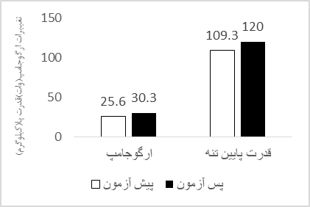
Results

Slide 10
Discussion and Conclusion
The most important findings of the present study which intended to investigate the supplementary impact of vitamin D on PTH levels and biomotor components among elite futsal players of the deaf National Team, revealed a significant increase in serum concentration of vitamin D, 1-RM and ergo jump in supplement group. However, there was no significant change in the level of parathyroid hormone, calcium and other biomotor components.

Slide 11
Discussion and Conclusion
The most favorable outcome of the present study is that vitaminD levels are critical for skeletal muscle function. Therefore, athletes should be evaluated 25 (OH)D during the year, in case of supplementation problems .

Slide 12
Applications and Executive Suggestions
• Supplementary vitamin D prompts physiological responses in skeletal muscles and thereby improves performance 1-RM, ergo jump and increase of vitamin D (19 ng/ml).
• The most important result of this research showed that an optimal level of vitamin D plays a vital role in the function of skeletal muscle

